Slide 1
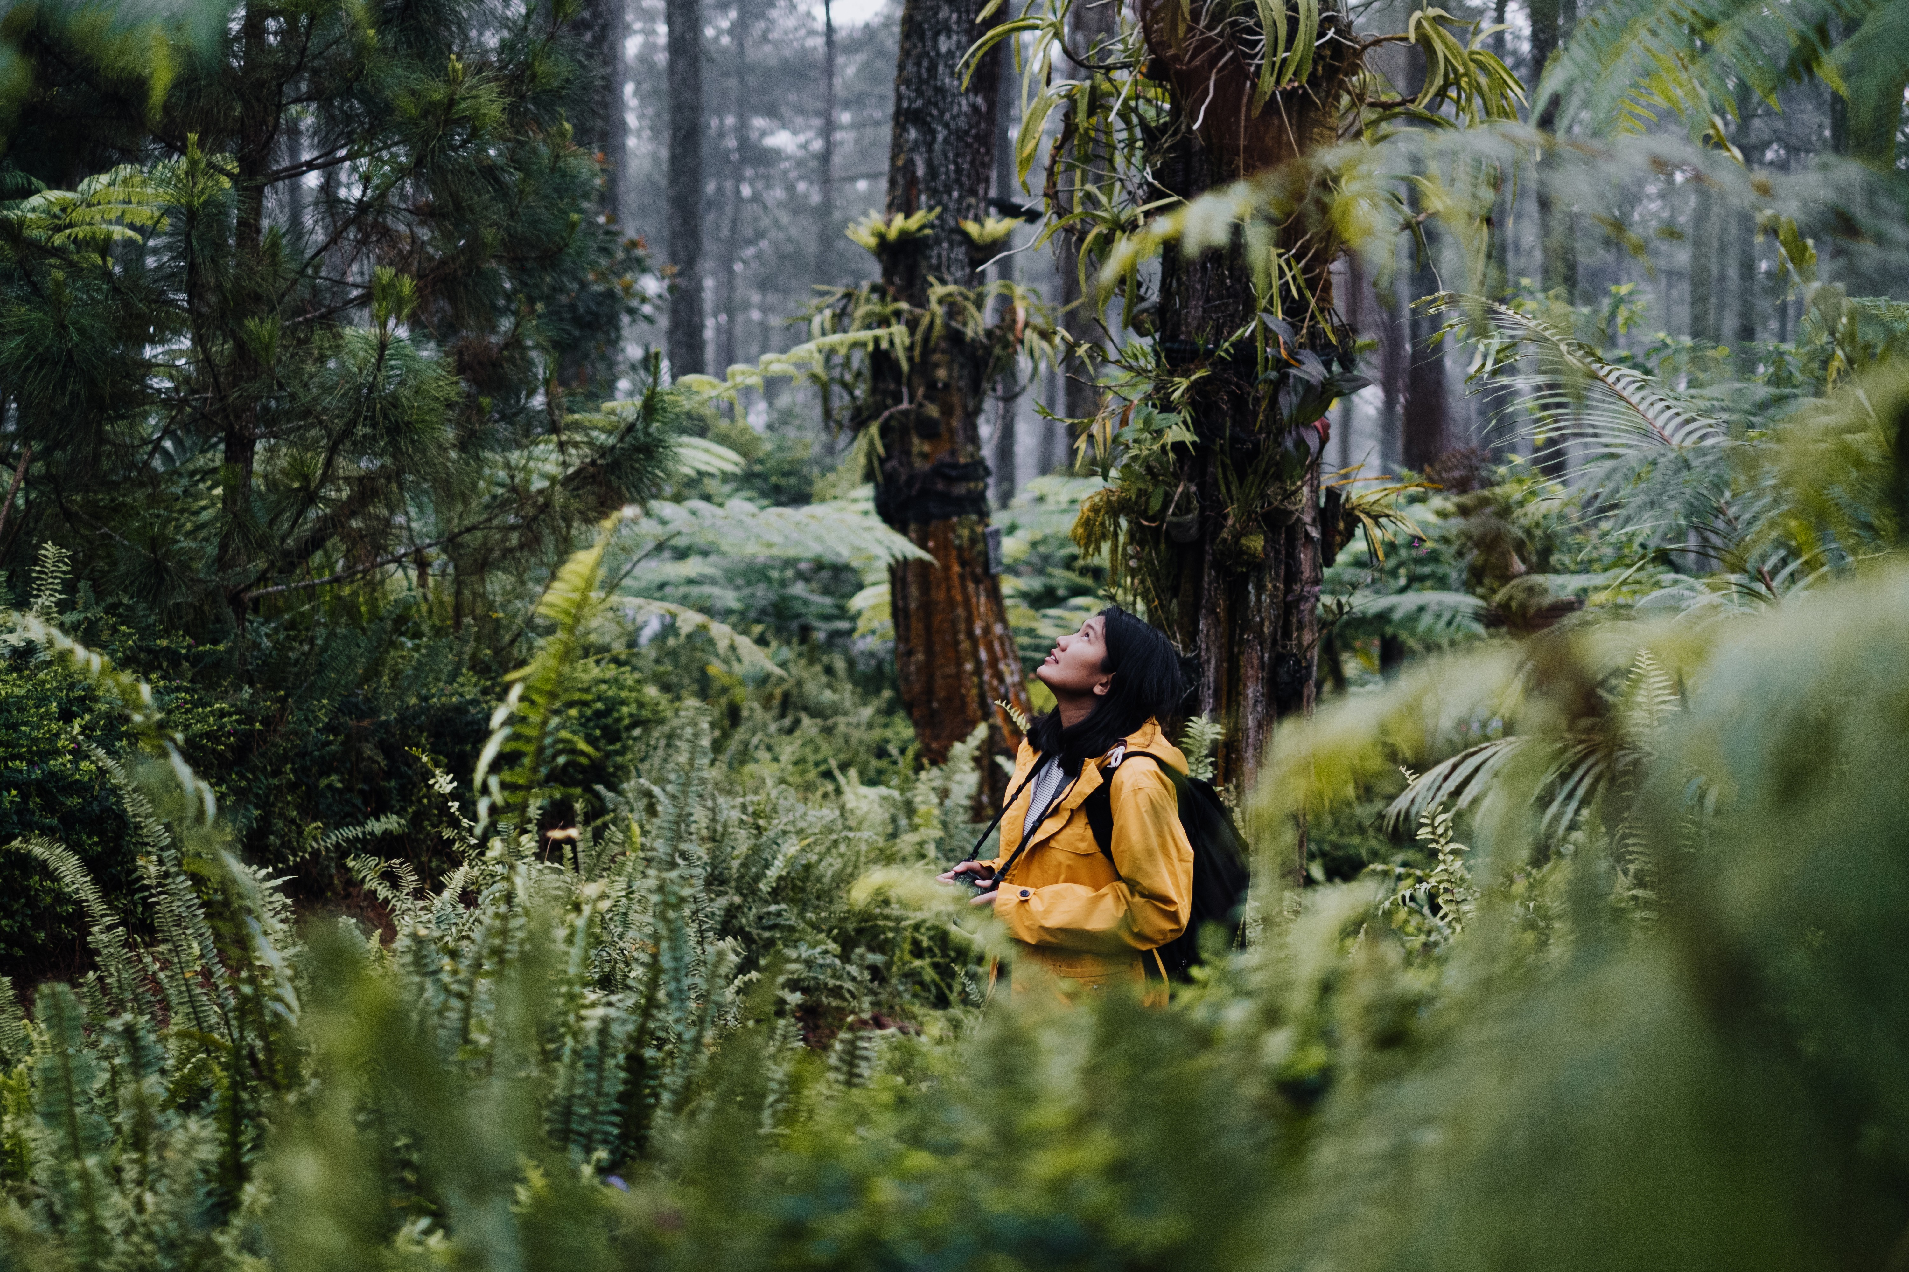
Biodiversity Dashboard for Reforestation Projects
IBM Call for Code Challenge 2022 Submission
October 2022
Notes:
Timings:
1 mins – Rupen – intro
5 mins – Francois – NextWave, objective, background
15 min – Greg – Tree Global
15 min – Jonathan – Natural State
5 min – Francois, Cathy - Creating long term value
5 mins – Rupen – EYFC and You, next steps
10 mins – Q&A
Total = 56 mins

Slide 2

Agenda
1
The issue
2
The solution
3
Natural State
4
Creating long-term value
5
Future enhancements

Slide 3
1
The Issue

Slide 4
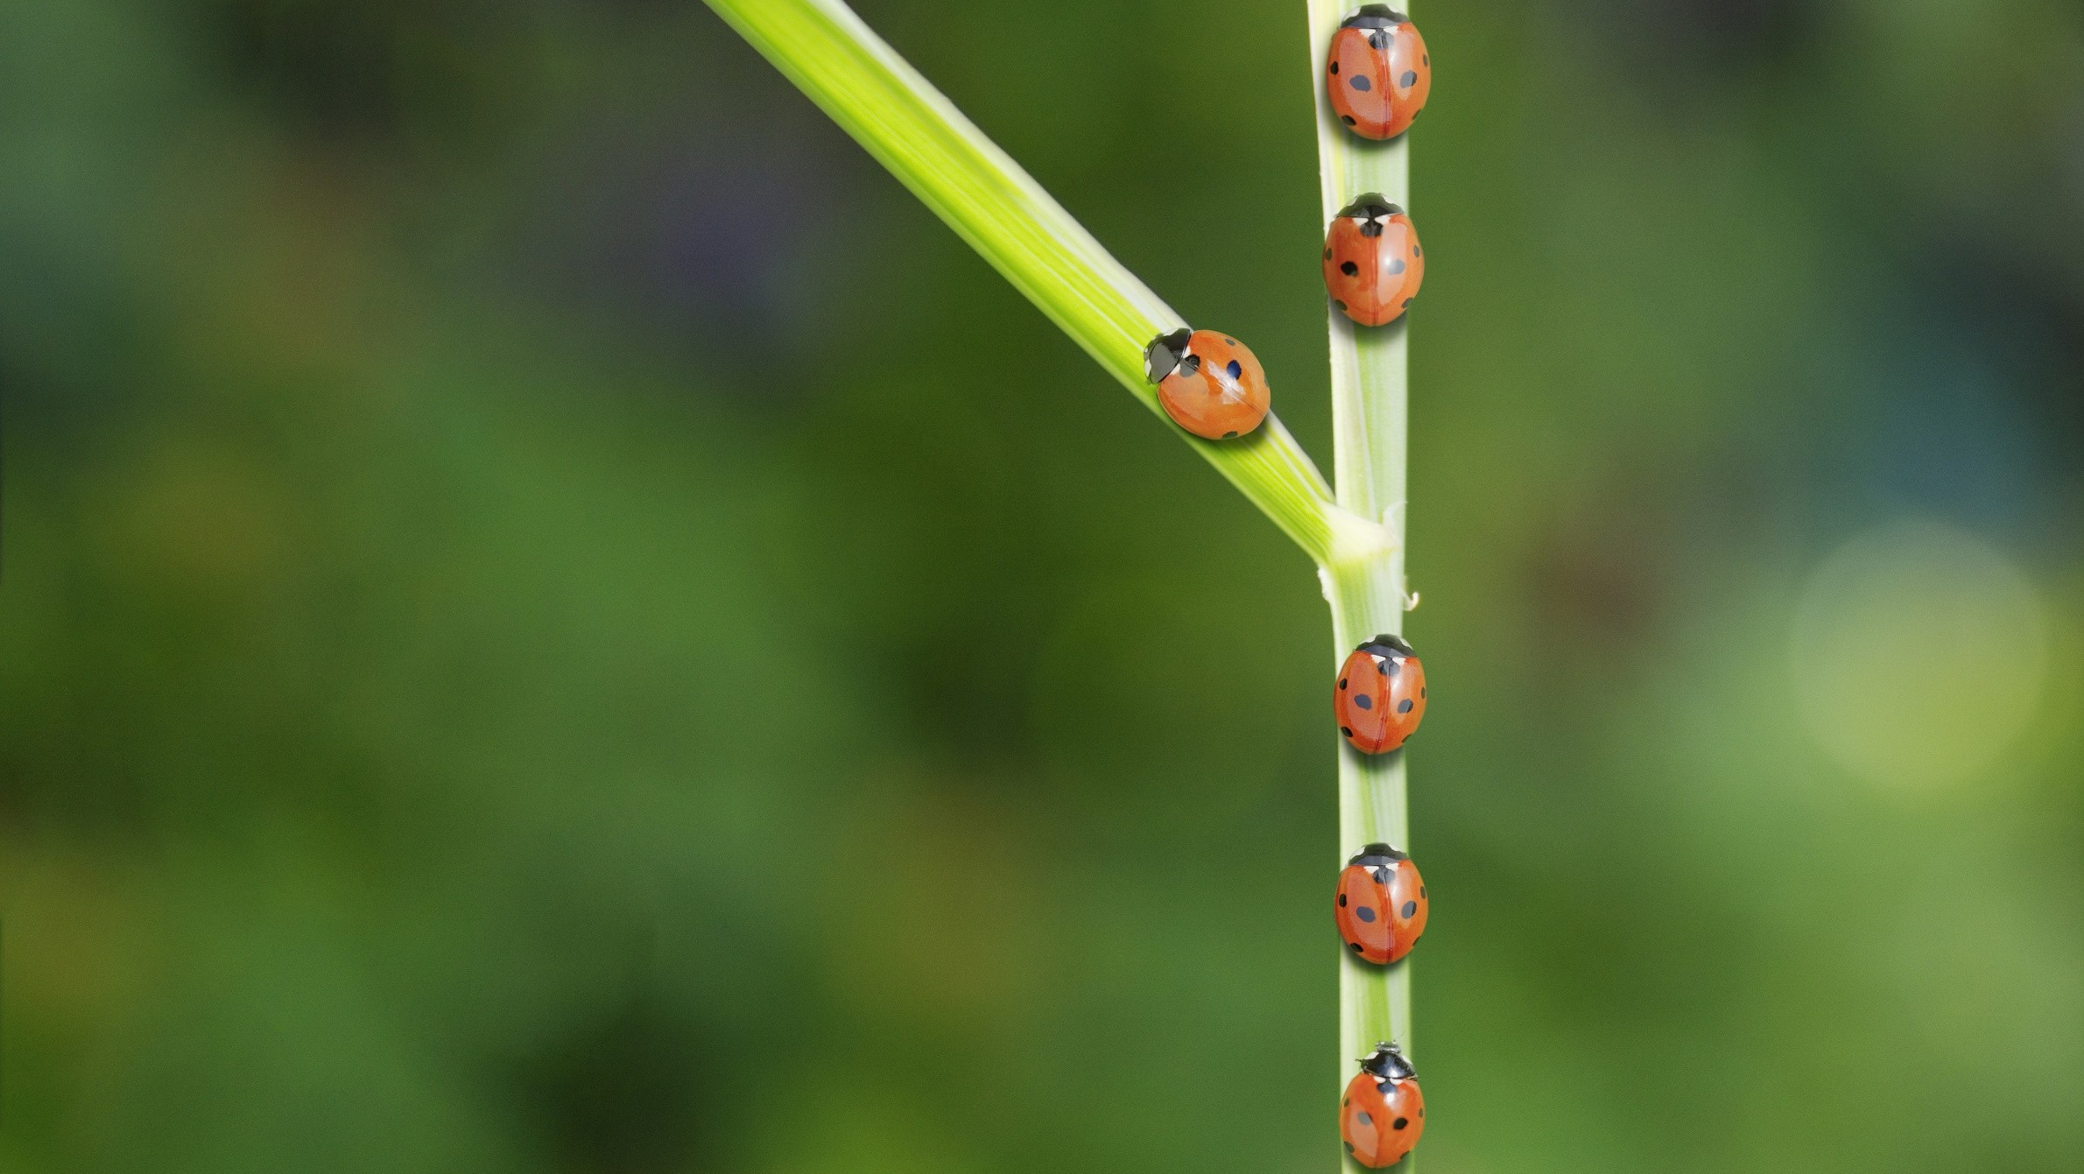

The Issue
Data showing the co-benefits of reforestation projects need to be accurately measured and analysed in an easy-to-understand format to increase trust and transparency in voluntary carbon markets. Currently, a lack of good data is keeping capital from going to projects that increase biodiversity, social impacts, and carbon sequestration.
Page 3

Slide 5
2
The Solution

Slide 6

The solution
Data, such as satellite images, acoustic sensors, and camera traps, need to be analysed by machine learning and artificial intelligence to figure out what kinds of species are there. This data can be used to look at the trend of biodiversity and how it changes over time. A digestible dashboard provides transparency to investors and stakeholders, such as governments and NGOs.
Page 5

Slide 7
3
Further information

Slide 8
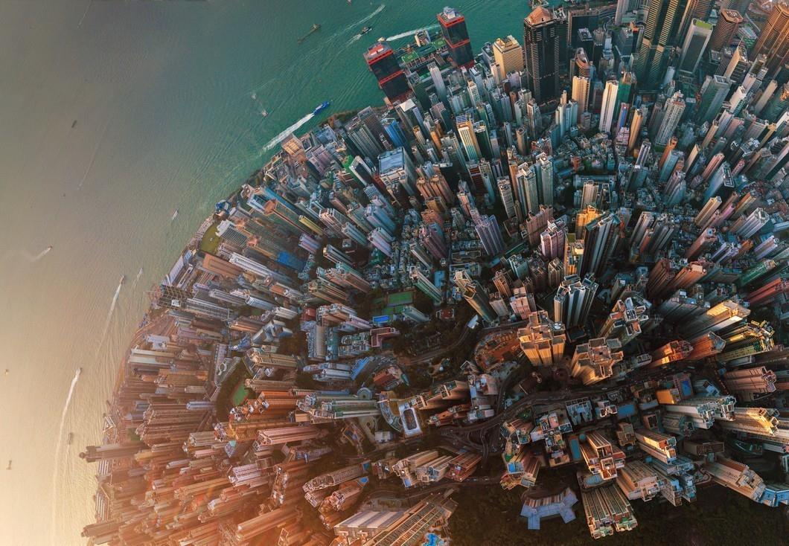
Background
How do we increase the flow of capital to biodiversity projects?
Currently, biodiversity is under valued. On the other hand, the price of carbon credits is estimated to reach up to $200 per unit by 2050 as the demand to offset emissions increases.
With the upcoming Taskforce on Nature-related Financial Disclosures (TNFD) recommendations, biodiversity and social impacts, or co-benefits, of reforestation projects will attract increasing value as regulation and demand evolves.
But to avoid greenwashing, gain the trust of investors and show transparency, technology is required to provide comfort that the investments are having a direct impact on biodiversity and local communities, which is difficult to capture, record, analyse and visualise.
Page 7

Slide 9

Artificial Intelligence and Machine Learning
Our solution uses artificial intelligence (AI) and machine learning to cost effectively and efficiently interpret data taken from camera traps to identify various species within a specific location.
At the onset of a reforestation project, a baseline measurement is taken of local biodiversity indicators. Once the trees are planted, regular measurements can be taken to observe the increase in plants, animals and insects over time, compared to the initial baseline measurements. As the forests mature, biodiversity will increase.
This increase in biodiversity, once verified by an independent body, can provide investors, governments and local agencies assurance that their investments into ‘Biodiversity credits’ have delivered on their objectives.
These measurements will be available to view on an easy to understand dashboard which shows the increase in biodiversity in specific locations over a designated period in time.
Page 8

Slide 10
The code
Images of animals captured by camera traps in the reforested areas are analysed by the AI model to identify the species. This information is stored for further analysis and visualisation via a live dashboard. Historical data and location specific data can all be accessed through this dashboard.
Page 9

Slide 11
Future enhancements
The analysis of satellite images and acoustic sensors will also be integrated into our AI and machine learning models to further increase machine learning model accuracy.
The next stage of our solution will be to quantify, measure and share the impact of reforestation projects on local communities, from job creation to increases in health and education.
The measurement of trees, including size and coverage, will also be required to calculate the amount of CO2 sequestered by the reforested areas.
Page 10

Slide 12
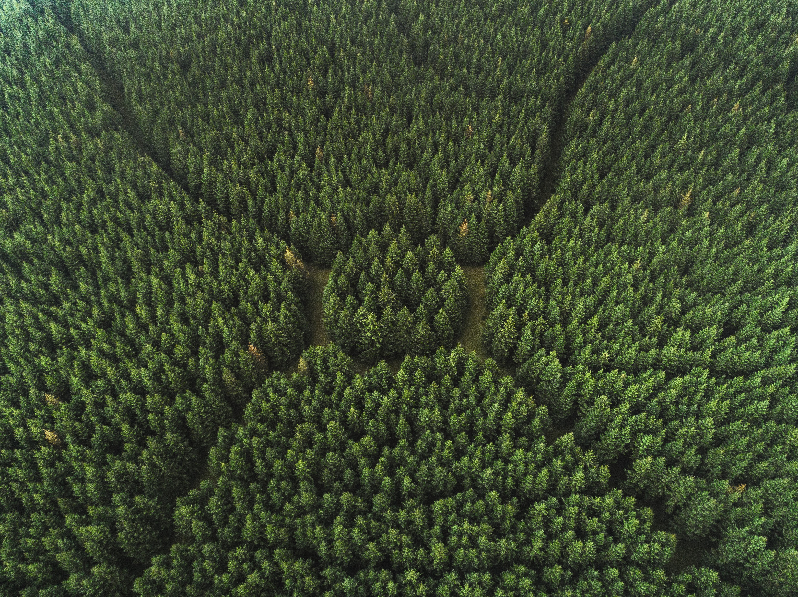
Thank you!
Notes:
Timings:
1 mins – Rupen – intro
5 mins – Francois – NextWave, objective, background
15 min – Greg – Tree Global
15 min – Jonathan – Natural State
5 min – Francois, Cathy - Creating long term value
5 mins – Rupen – EYFC and You, next steps
10 mins – Q&A
Total = 56 mins

